Slide 1


Siber's Technologies
----AI Study Assistant----

Slide 2

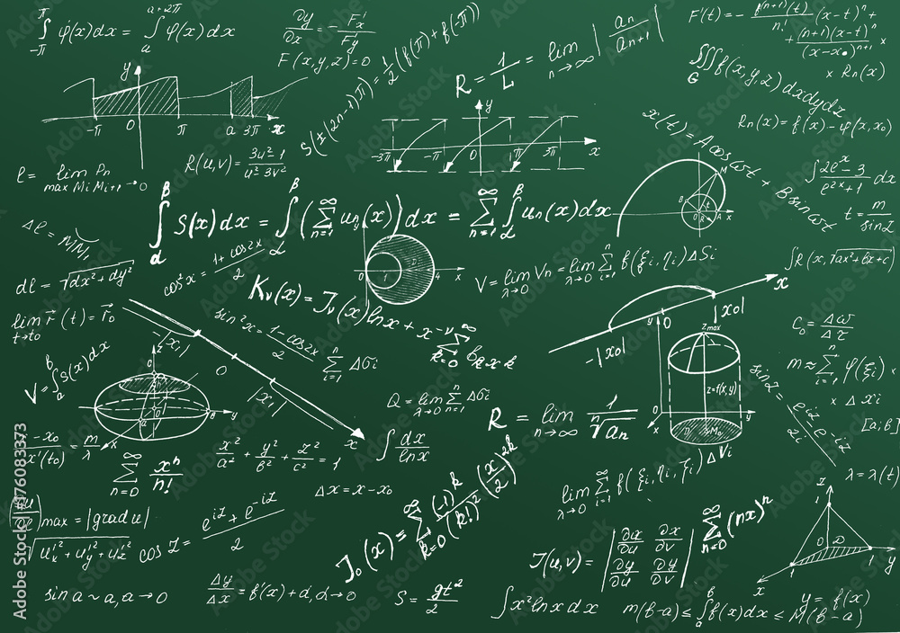
Problem :
IDK how to solve this

Slide 3
Features :
Real Time Helper
Personalized Quizzes
Instant Summarization
AI Study Assistant
Multi-Language Support
Voice & Text Recognition
Android and IOS Devices
Other features

Slide 4

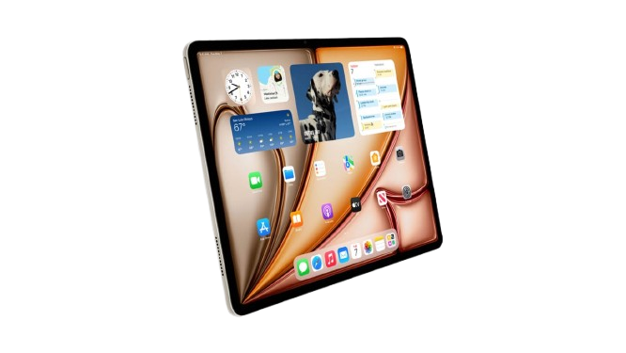


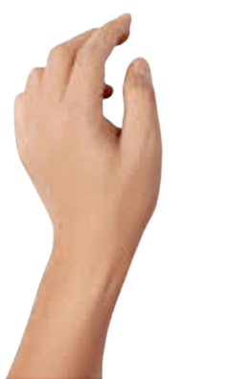











AI Study Assistant
You can subtract 2 from both sides to solve the equation.

Slide 5


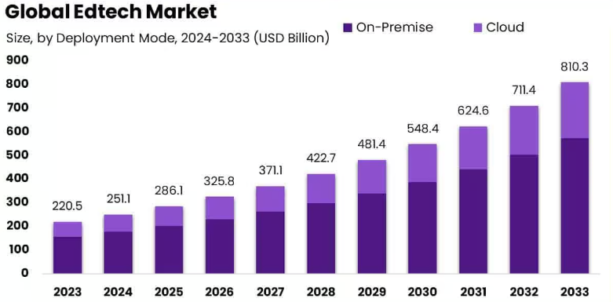



Why Invest in AI Study Assistant Right Now?
2025 -> 2033
280 USD Billion -> 900 USD Billion
The EdTech market is booming
Latest AI models
Succesful experiences
90% of Succes

Slide 6
What are we seeking for?
$500,000 for 20% equity

Slide 7
How Will the Investment Be Used?
Developing and training our own AI models
Marketing
Team Expansion

Slide 8
Thank you!
Let’s revolutionize learning together. Invest in the future!
Siber's Technologies
----AI Study Assistant----

